Slide 1
Event Centralizer: Solving Student Career Event Discovery
Streamlining access to career events for student success
Notes:
AI-generated content may be incorrect. ---

Slide 2
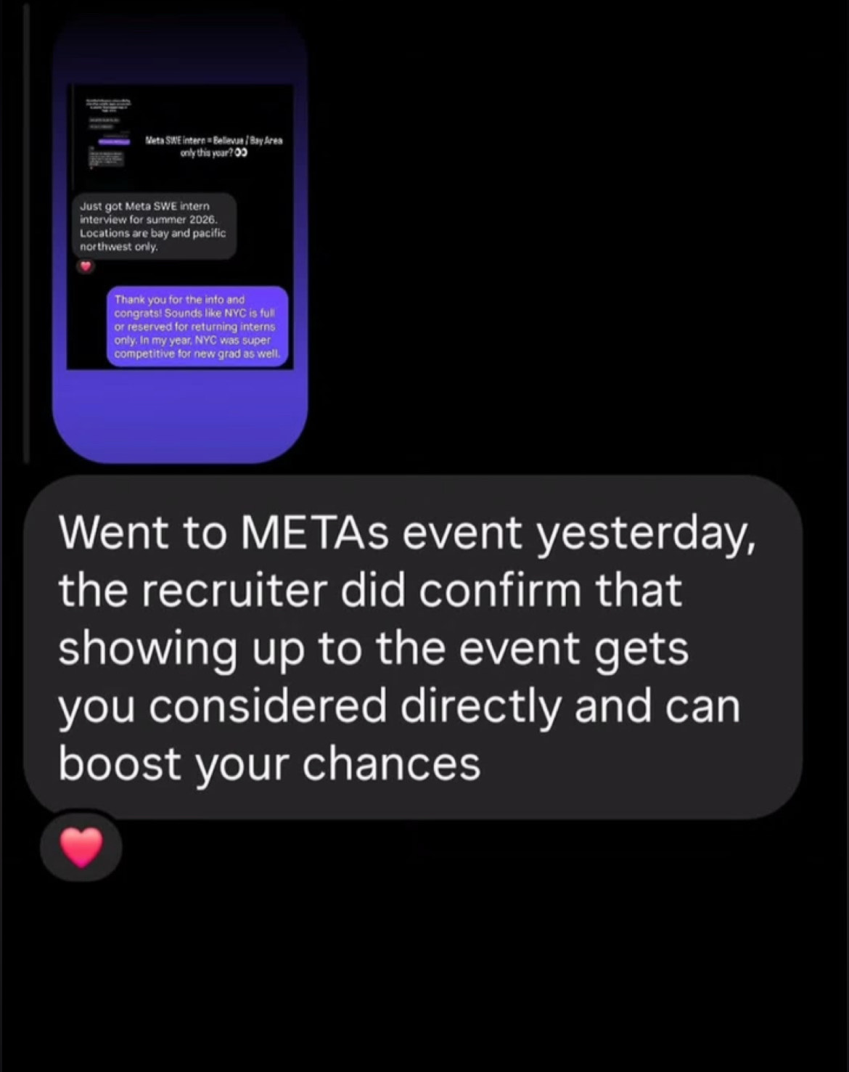
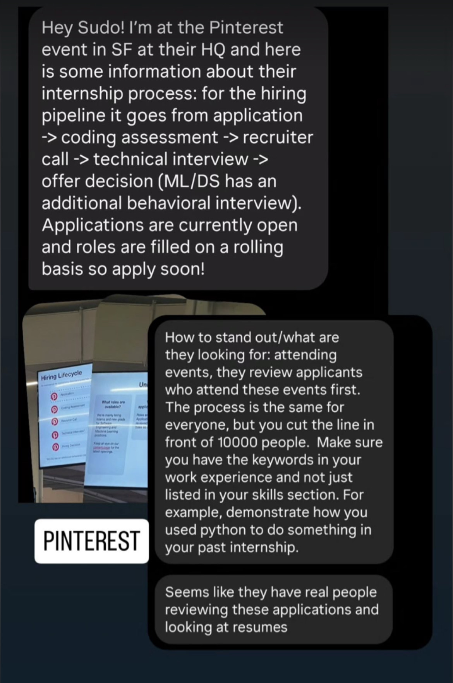
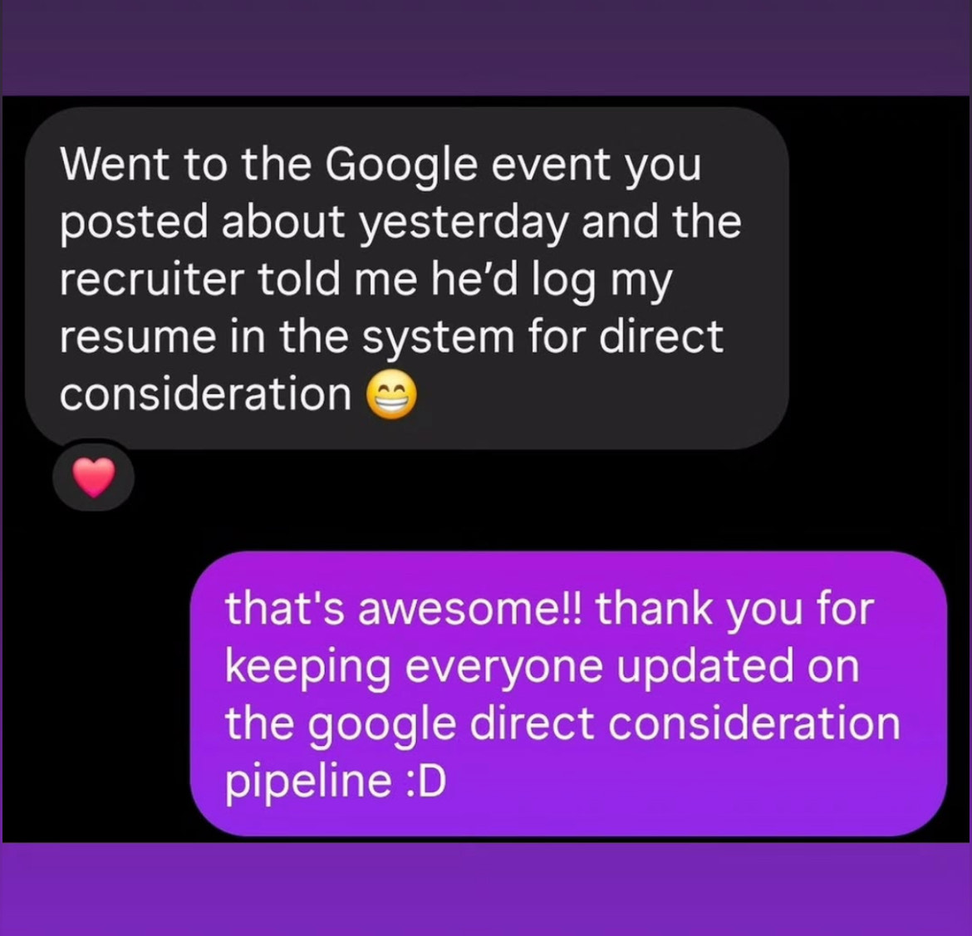
Introduction
Notes:
Event Centralizer Overview

Slide 3
Problem Definition
Notes:
Challenges Faced by Students

Slide 4

Challenges Faced by Students
Fragmented Event Information
Students face difficulties due to event details being spread across emails, flyers, and social media.
Missed Career Opportunities
Poor information visibility causes students to miss direct recruiter engagement and job consideration events.
Importance of Centralized Access
Consolidating event details ensures students timely access and increases chances of recruiter interactions.
Notes:
University students frequently miss out on career-enhancing events due to fragmented information sources and poor visibility. Events such as job fairs, hackathons, and info sessions are often advertised through disparate channels like emails, flyers, or social media, making it difficult for students to stay informed. This lack of centralized access results in missed opportunities for direct recruiter engagement and job consideration. Real-world examples from student conversations highlight the urgency of this issue. For instance, attending a Google event led to a recruiter offering direct resume consideration, while participation in TikTok and Meta sessions increased visibility in the hiring pipeline. These anecdotes underscore the need for a solution that consolidates event information and ensures timely access for students.

Slide 5
Solution Overview
Notes:
How Event Centralizer Works

Slide 6
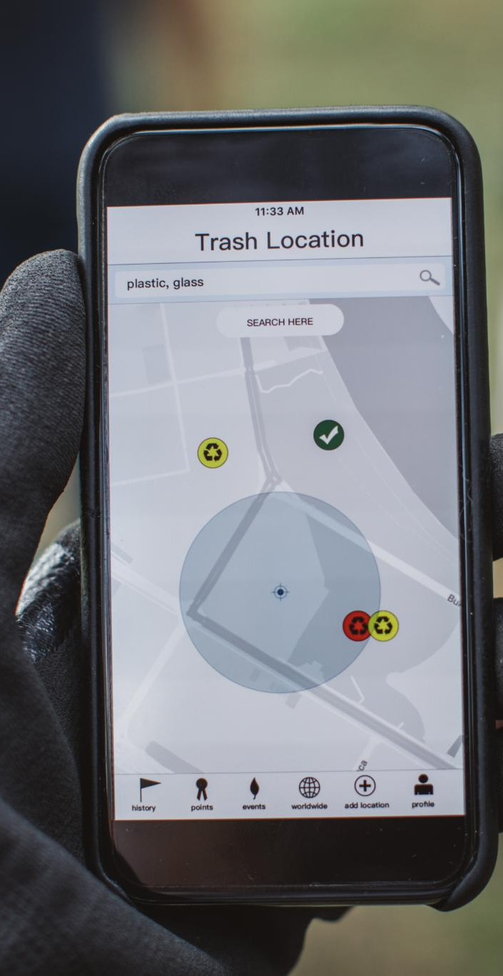
Event Centralizer Overview
Purpose and Audience
Event Centralizer targets university students to help them find and attend career-related events effortlessly.
Event Variety and Formats
The app lists diverse events including hackathons, job fairs, seminars, and workshops in various formats: in-person, virtual, or hybrid.
Radar-Style Event Map
A radar-style map feature shows event locations and formats citywide, simplifying event discovery and planning.
Centralized Career Access
Aggregating events into one platform ensures students stay informed and never miss valuable networking opportunities.
Notes:
Event Centralizer is a mobile application designed to help university students discover and attend career-related events such as hackathons, job fairs, seminars, and workshops. These events are often hosted by companies and recruiters and can be in-person, virtual, or hybrid. The app features a radar-style map that displays the location and format of events across the city, making it easier for students to plan and attend. The tagline, 'From board room to zoom, we got all covered,' encapsulates the app’s mission to centralize and simplify access to career opportunities. By aggregating event data into a single platform, Event Centralizer ensures students never miss out on valuable networking and recruitment chances.

Slide 7

How Event Centralizer Works
Unified Event Discovery
The platform aggregates career event listings, categorizing them by type, format, and location for easy discovery.
Radar-Style Event Map
A radar-style map visually displays events across the city, helping users filter and navigate based on preferences.
Real-Time Notifications and RSVP
Users receive instant event notifications and can RSVP directly, ensuring timely participation and planning.
Calendar Integration
Seamless calendar integration allows users to manage their schedules and plan event attendance effectively.
Notes:
Event Centralizer addresses the problem by offering a unified platform where students can discover all relevant career events. The app aggregates listings from companies and recruiters, categorizing them by type (e.g., hackathon, seminar), format (in-person, virtual, hybrid), and location. A radar-style map provides a visual overview of events happening across the city, allowing users to filter and navigate based on their preferences. Key features include real-time notifications, RSVP capabilities, and calendar integration. This functionality ensures students are always informed and can plan their attendance effectively. By streamlining event discovery and participation, Event Centralizer empowers students to take control of their career development.

Slide 8
Impact and Use Case
Notes:
Why Event Centralizer Matters

Slide 9

Why Event Centralizer Matters
Impact on Student Careers
Attending company-hosted events can lead to direct job consideration and improve recruitment visibility for students.
Real-Life Success Examples
Students who participate in events like Google and TikTok info sessions get special job application advantages.
Centralized Platform Advantage
Event Centralizer provides a reliable platform to ensure students never miss important professional development events.
Career Guidance Role
The app acts as a career compass guiding students through professional events and helping seize opportunities.
Notes:
Event Centralizer has a significant impact on university students, particularly in urban areas like Chicago. Real-life examples show that attending events hosted by companies like Google, TikTok, and Meta can lead to direct job consideration and increased visibility in the recruitment process. For instance, a student who attended a Google event was promised resume logging for direct consideration, while another who joined a TikTok info session had their application flagged. These scenarios demonstrate the value of timely event participation. Event Centralizer ensures students never miss such opportunities by providing a reliable and centralized platform. It’s more than an app—it’s a career compass that guides students through the maze of professional development events, helping them make informed decisions and seize critical opportunities.

